Slide 1
CS 61C: Great Ideas in Computer Architecture (Machine Structures) Caches Part 3
Instructors:
Krste Asanović & Randy H. Katz
http://inst.eecs.berkeley.edu/~cs61c/
10/19/17
Fall 2017 - Lecture #16

Slide 2
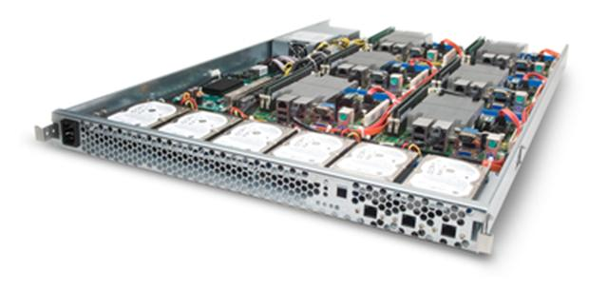
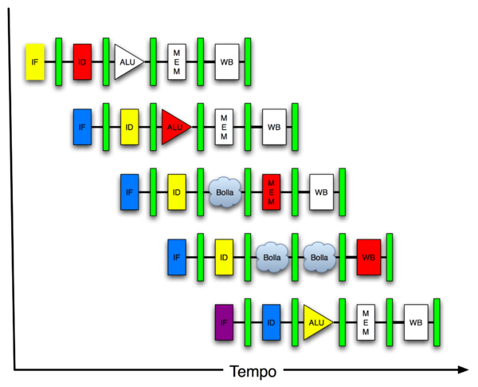
You Are Here!
Software Hardware
Parallel Requests
Assigned to computer
e.g., Search “Katz”
Parallel Threads
Assigned to core
e.g., Lookup, Ads
Parallel Instructions
>1 instruction @ one time
e.g., 5 pipelined instructions
Parallel Data
>1 data item @ one time
e.g., Add of 4 pairs of words
Hardware descriptions
All gates @ one time
Programming Languages
Warehouse Scale Computer
Smart Phone
Harness Parallelism &
Achieve High Performance
Computer
Today’s
Lecture
Core
…
Core
Memory (Cache)
Input/Output
Core
Instruction Unit(s)
Functional
Unit(s)
A₀+B₀
A₁+B₁
A₂+B₂
A₃+B₃
Main Memory
Logic Gates
10/19/17
Fall 2017 - Lecture #16

Slide 3
Typical Memory Hierarchy
On-Chip Components
Control
Third-Level
Cache
(SRAM)
Instr
Cache
Second-Level
Cache
(SRAM)
Main
Memory
(DRAM)
Secondary
Memory
(Disk
Or Flash)
Datapath
RegFile
Data
Cache
Speed (cycles): ½’s 1’s 10’s 100’s-1000 1,000,000’s
Size (bytes): 100’s 10K’s M’s G’s T’s
Cost/bit: highest lowest
Principle of locality + memory hierarchy presents programmer with ≈ as much memory as is available in the cheapest technology at the ≈ speed offered by the fastest technology
10/19/17
Fall 2017 - Lecture #16
Notes:
Instead, the memory system of a modern computer consists of a series of black boxes ranging from the fastest to the slowest.
Besides variation in speed, these boxes also varies in size (smallest to biggest) and cost.
What makes this kind of arrangement work is one of the most important principle in computer design. The principle of locality. The principle of locality states that programs access a relatively small portion of the address space at any instant of time.
The design goal is to present the user with as much memory as is available in the cheapest technology (points to the disk).
While by taking advantage of the principle of locality, we like to provide the user an average access speed that is very close to the speed that is offered by the fastest technology.
(We will go over this slide in detail in the next lectures on caches).

Slide 4
Review: Direct-Mapped Cache
One word blocks, cache size = 1K words (or 4KB)
Byte within block offset
31 30 . . . 13 12 11 . . . 2 1 0
Hit
Tag
20
10
Data
Valid bit ensures something useful in cache for this index
Index
Read data from cache instead of memory if a Hit
Index
Valid
Tag
Data
0
1
2
.
.
.
1021
1022
1023
Compare Tag with upper part of Address to see if a Hit
20
32
Comparator
10/19/17
Fall 2017 - Lecture #16
Notes:
Let’s use a specific example with realistic numbers: assume we have a 1 K word (4Kbyte) direct mapped cache with block size equals to 4 bytes (1 word).
In other words, each block associated with the cache tag will have 4 bytes in it (Row 1).
With Block Size equals to 4 bytes, the 2 least significant bits of the address will be used as byte select within the cache block.
Since the cache size is 1K word, the upper 32 minus 10+2 bits, or 20 bits of the address will be stored as cache tag.
The rest of the (10) address bits in the middle, that is bit 2 through 11, will be used as Cache Index to select the proper cache entry
Temporal!

Slide 5
Review: Four-Way Set-Associative Cache
2⁸ = 256 sets each with four ways (each with one word block)
31 30 . . . 11 10 9 . . . 2 1 0
Byte within block offset
Tag
22
8
Index
Index
V
Tag
Data
V
Tag
Data
V
Tag
Data
V
Tag
Data
0
1
2
.
.
.
253
254
255
0
1
2
.
.
.
253
254
255
0
1
2
.
.
.
253
254
255
0
1
2
.
.
.
253
254
255
Way 0
Way 1
Way 2
Way 3
32
# Sets x # Ways = # Blocks
# Blocks x Bytes/Block = Cache Capacity
4x1 select
10/19/17
Fall 2017 - Lecture #16
Hit
Data
Notes:
This is called a 4-way set associative cache because there are four cache entries for each cache index. Essentially, you have four direct mapped cache working in parallel.
This is how it works: the cache index selects a set from the cache. The four tags in the set are compared in parallel with the upper bits of the memory address.
If no tags match the incoming address tag, we have a cache miss.
Otherwise, we have a cache hit and we will select the data from the way where the tag matches occur.
This is simple enough. What is its disadvantages?
+1 = 36 min. (Y:16)

Slide 6
Review: Range of Set-Associative Caches
For a fixed-size cache and fixed block size, each increase by a factor of two in associativity doubles the number of blocks per set (i.e., the number or ways) and halves the number of sets – decreases the size of the index by 1 bit and increases the size of the tag by 1 bit
Used for tag compare
Selects the set
Selects the word in the block
Tag
Index
Word offset
Byte offset
Increasing associativity, more ways, less sets
Decreasing associativity, less ways, more sets
Fully associative
(only one set)
Tag is all the bits except
word and byte offset
Direct mapped
(only one way)
Smaller tags, only a single comparator
# Sets x # Ways = # Blocks
# Blocks x Bytes/Block = Cache Capacity
10/19/17
Fall 2017 - Lecture #15
Notes:
For lecture
In 2008, the greater size and power consumption of CAMs generally leads to 2-way and 4-way set associativity being built from standard SRAMs with comparators with 8-way and above being built using CAMs

Slide 7
Review: Costs of Set-Associative Caches
N-way set-associative cache costs
N comparators (delay and area)
MUX delay (set selection) before data is available
Data available after set selection (and Hit/Miss decision). DM $: block is available before the Hit/Miss decision
In Set-Associative, not possible to just assume a hit and continue and recover later if it was a miss
When miss occurs, which way’s block selected for replacement?
Least Recently Used (LRU): one that has been unused the longest (principle of temporal locality)
Must track when each way’s block was used relative to other blocks in the set
For 2-way SA $, one bit per set → set to 1 when a block is referenced; reset the other way’s bit (i.e., “last used”)
10/19/17
Fall 2017 - Lecture #16
Notes:
First of all, a N-way set associative cache will need N comparators instead of just one comparator (use the right side of the diagram for direct mapped cache).
A N-way set associative cache will also be slower than a direct mapped cache because of this extra multiplexer delay.
Finally, for a N-way set associative cache, the data will be available AFTER the hit/miss signal becomes valid because the hit/mis is needed to control the data MUX.
For a direct mapped cache, that is everything before the MUX on the right or left side, the cache block will be available BEFORE the hit/miss signal (AND gate output) because the data does not have to go through the comparator.
This can be an important consideration because the processor can now go ahead and use the data without knowing if it is a Hit or Miss. Just assume it is a hit.
Since cache hit rate is in the upper 90% range, you will be ahead of the game 90% of the time and for those 10% of the time that you are wrong, just make sure you can recover.
You cannot play this speculation game with a N-way set-associative cache because as I said earlier, the data will not be available to you until the hit/miss signal is valid.
+2 = 38 min. (Y:18)

Slide 8
Review: Cache Replacement Policies
Random Replacement
Hardware randomly selects a cache block for eviction
Least-Recently Used
Hardware keeps track of access history
Replace the entry that has not been used for the longest time
For 2-way set-associative cache, need one bit for LRU replacement
Example of a Simple “Pseudo” LRU Implementation
Assume 64 Fully Associative entries
Hardware replacement pointer points to one cache entry
Whenever access is made to the entry the pointer points to:
Move the pointer to the next entry
Otherwise: do not move the pointer
(example of “not-most-recently used” replacement policy)
Entry 0
Entry 1
Replacement
:
Pointer
Entry 63
10/19/17
Fall 2017 - Lecture #16

Slide 9
Review: Write Policy Choices
Cache Hit:
Write through: writes both cache & memory on every access
Generally higher memory traffic but simpler pipeline & cache design
Write back: writes cache only, memory written only when dirty entry evicted
A dirty bit per line reduces write-back traffic
Must handle 0, 1, or 2 accesses to memory for each load/store
Cache Miss:
No write allocate: only write to main memory
Write allocate (aka fetch on write): fetch into cache
Common combinations:
Write through and no write allocate
Write back with write allocate
10/19/17
Fall 2017 - Lecture #16

Slide 10
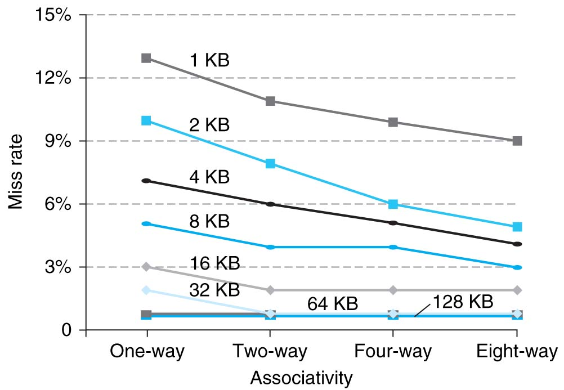
Review: Benefits of Set-Associative Caches
Choice of DM $ vs. SA $ depends on cost of a miss vs. cost of implementation
Largest gains are in going from direct mapped to 2-way (20%+ reduction in miss rate)
10/19/17
Fall 2017 - Lecture #16
Notes:
As cache sizes grow, the relative improvement from associativity increases only slightly; since the overall miss rate of a larger cache is lower, the opportunity for improving the miss rate decreases and the absolute improvement in miss rate from associativity shrinks significantly.

Slide 11
Review: Average Memory Access Time (AMAT)
Average Memory Access Time (AMAT) is the average time to access memory considering both hits and misses in the cache
AMAT = Time for a hit + Miss rate × Miss penalty
Important Equation!
10/19/17
Fall 2017 - Lecture #16
Notes:
AMAT = 1 + 0.02x50 = 2

Slide 12
Outline
Understanding Cache Misses
Increasing Cache Performance
Performance of multi-level Caches (L1,L2, …)
Real world example caches
And in Conclusion …
10/19/17
Fall 2017 – Lecture #16

Slide 13
Outline
Understanding Cache Misses
Increasing Cache Performance
Performance of multi-level Caches (L1,L2, …)
Real world example caches
And in Conclusion …
10/19/17
Fall 2017 – Lecture #16

Slide 14
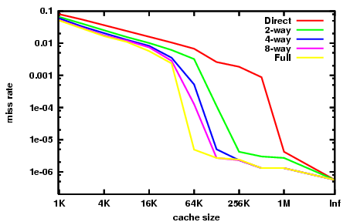
Miss Rate vs. Cache Size on the Integer Portion of SPECCPU2000

Slide 15
Sources of Cache Misses (3 C’s)
Compulsory (cold start, first reference):
1st access to a block, not a lot you can do about it
If running billions of instructions, compulsory misses are insignificant
Capacity:
Cache cannot contain all blocks accessed by the program
Misses that would not occur with infinite cache
Conflict (collision):
Multiple memory locations mapped to same cache set
Misses that would not occur with ideal fully associative cache
10/19/17
Fall 2017 - Lecture #16
Notes:
(Capacity miss) That is the cache misses are due to the fact that the cache is simply not large enough to contain all the blocks that are accessed by the program.
The solution to reduce the Capacity miss rate is simple: increase the cache size.
Here is a summary of other types of cache miss we talked about.
First is the Compulsory misses. These are the misses that we cannot avoid. They are caused when we first start the program.
Then we talked about the conflict misses. They are the misses that caused by multiple memory locations being mapped to the same cache location.
There are two solutions to reduce conflict misses. The first one is, once again, increase the cache size. The second one is to increase the associativity.
For example, say using a 2-way set associative cache instead of directed mapped cache.
But keep in mind that cache miss rate is only one part of the equation. You also have to worry about cache access time and miss penalty. Do NOT optimize miss rate alone.
Finally, there is another source of cache miss we will not cover today. Those are referred to as invalidation misses caused by another process, such as IO , update the main memory so you have to flush the cache to avoid inconsistency between memory and cache.
+2 = 43 min. (Y:23)

Slide 16
How to Calculate 3C’s Using Cache Simulator
Compulsory: set cache size to infinity and fully associative, and count number of misses
Capacity: Change cache size from infinity, usually in powers of 2, and count misses for each reduction in size
16 MB, 8 MB, 4 MB, … 128 KB, 64 KB, 16 KB
Conflict: Change from fully associative to n-way set associative while counting misses
Fully associative, 16-way, 8-way, 4-way, 2-way, 1-way
10/19/17
Fall 2017 - Lecture #16

Slide 17
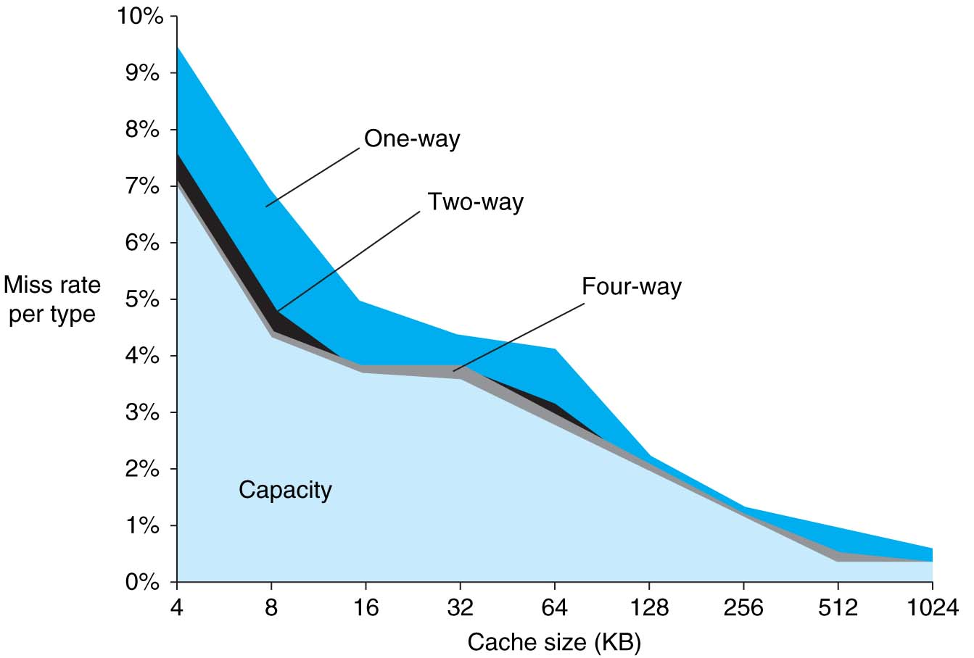
3Cs Analysis
Three sources of misses (SPEC2000 integer and floating-point benchmarks)
Compulsory misses 0.006%; not visible
Capacity misses, function of cache size
Conflict portion depends on associativity and cache size
10/19/17
Fall 2017 - Lecture #16

Slide 18
Outline
Understanding Cache Misses
Increasing Cache Performance
Performance of multi-level Caches (L1,L2, …)
Real world example caches
And in Conclusion …
10/19/17
Fall 2017 – Lecture #16

Slide 19
Pipelined RISC-V RV32I Datapath (with I,D$)
Recalculate PC+4 in M stage to avoid sending both PC and PC+4 down pipeline
pc_{X}
pc_{M}
pc_{F}
pc_{D}
+4
+4
Reg[]
rs1_{X}
1
DataD
DataA
ALU
alu_{X}
DMEM
0
AddrD
alu_{M}
Addr
pc_{F}+4
IMEM
Branch Comp.
DataR
AddrA
DataW
“Bubble”
AddrB
DataB
inst_{D}
Primary D$
pc_{F}
Primary I$
rs2_{X}
rs2_{M}
Addr DataR
DataW
Addr Instr
inst_{D}
imm_{X}
Imm.
inst_{X}
inst_{M}
Hit?
Hit?
inst_{W}
PC_{en}
Memory Controller & Stall entire CPU on D$ miss
Write Back/Thru to Memory
To Memory Controller
Refill D$ data from Lower Levels of Memory Hierarchy
Refill $ Data from Lower Levels of Memory Hierarchy
Must pipeline instruction along with data, so control operates correctly in each stage
10/19/17
Fall 2017 - Lecture #16

Slide 20
Improving Cache Performance
AMAT = Time for a hit + Miss rate x Miss penalty
Reduce the time to hit in the cache
E.g., Smaller cache
Reduce the miss rate
E.g., Bigger cache
Reduce the miss penalty
E.g., Use multiple cache levels
10/19/17
Fall 2017 - Lecture #16

Slide 21
Cache Design Space
Computer architects expend considerable effort optimizing organization of cache hierarchy – big impact on performance and power!
Several interacting dimensions
Cache size
Block size
Associativity
Replacement policy
Write-through vs. write-back
Write allocation
Optimal choice is a compromise
Depends on access characteristics
Workload
Use (I-cache, D-cache)
Depends on technology / cost
Simplicity often wins
Cache Size
Associativity
Block Size
Bad
Good
Factor A
Factor B
Less
More
10/19/17
Fall 2017 - Lecture #16
Notes:
No fancy replacement policy is needed for the direct mapped cache.
As a matter of fact, that is what cause direct mapped trouble to begin with: only one place to go in the cache--causes conflict misses.
No fancy replacement policy is needed for the direct mapped cache.
As a matter of fact, that is what cause direct mapped trouble to begin with: only one place to go in the cache--causes conflict misses.
Besides working at Sun, I also teach people how to fly whenever I have time.
Statistic have shown that if a pilot crashed after an engine failure, he or she is more likely to get killed in a multi-engine light airplane than a single engine airplane.
The joke among us flight instructors is that: sure, when the engine quit in a single engine stops, you have one option: sooner or later, you land. Probably sooner.
But in a multi-engine airplane with one engine stops, you have a lot of options. It is the need to make a decision that kills those people.

Slide 22
Break!
10/19/17
Fall 2017 - Lecture #16

Slide 23
Peer Instruction
For a cache with constant total capacity, if we increase the number of ways by a factor of two, which statement is false:
A : The number of sets is halved
B : The tag width decreases
C : The block size stays the same
D : The set index decreases
10/19/17
Fall 2017 - Lecture #16

Slide 24
Peer Instruction
For a cache with constant total capacity, if we increase the number of ways by a factor of two, which statement is false:
A : The number of sets is halved
B : The tag width decreases
C : The block size stays the same
D : The set index decreases
10/19/17
Fall 2017 - Lecture #16

Slide 25
Peer Instruction
For S sets, N ways, B blocks, which statements hold?
(i) The cache has B tags
(ii) The cache needs N comparators
(iii) B = N x S
(iv) Size of Set Index = Log₂(S)
A : (i) only
B : (i) and (ii) only
C : (i), (ii), (iii) only
D : All four statements are true
10/19/17
Fall 2017 - Lecture #16

Slide 26
Peer Instruction
For S sets, N ways, B blocks, which statements hold?
(i) The cache has B tags
(ii) The cache needs N comparators
(iii) B = N x S
(iv) Size of Set Index = Log₂(S)
A : (i) only
B : (i) and (ii) only
C : (i), (ii), (iii) only
D : All four statements are true
10/19/17
Fall 2017 - Lecture #16

Slide 27
Primary Cache Parameters
Block size
How many bytes of data in each cache entry?
Associativity
How many ways in each set?
Direct-mapped => Associativity = 1
Set-associative => 1 < Associativity < #Entries
Fully associative => Associativity = #Entries
Capacity (bytes) = Total #Entries * Block size
#Entries = #Sets * Associativity
10/19/17
Fall 2017 - Lecture #16

Slide 28
Impact of Larger Cache on AMAT?
1) Reduces misses (what kind(s)?)
2) Longer Access time (Hit time): smaller is faster
Increase in hit time will likely add another stage to the pipeline
At some point, increase in hit time for a larger cache may overcome improvement in hit rate, yielding a decrease in performance
Computer architects expend considerable effort optimizing organization of cache hierarchy – big impact on performance and power!
10/19/17
Fall 2017 - Lecture #16
Notes:
AMAT = 1 + 0.02x50 = 2

Slide 29
Increasing Associativity?
Hit time as associativity increases?
Increases, with large step from direct-mapped to >=2 ways, as now need to mux correct way to processor
Smaller increases in hit time for further increases in associativity
Miss rate as associativity increases?
Goes down due to reduced conflict misses, but most gain is from 1->2->4-way with limited benefit from higher associativities
Miss penalty as associativity increases?
Unchanged, replacement policy runs in parallel with fetching missing line from memory
10/19/17
Fall 2017 - Lecture #16

Slide 30
Increasing #Entries?
Hit time as #entries increases?
Increases, since reading tags and data from larger memory structures
Miss rate as #entries increases?
Goes down due to reduced capacity and conflict misses
Architects rule of thumb: miss rate drops ~2x for every ~4x increase in capacity (only a gross approximation)
Miss penalty as #entries increases?
Unchanged
At some point, increase in hit time for a larger cache may overcome the improvement in hit rate, yielding a decrease in performance
10/19/17
Fall 2017 - Lecture #16

Slide 31
Increasing Block Size?
Hit time as block size increases?
Hit time unchanged, but might be slight hit-time reduction as number of tags is reduced, so faster to access memory holding tags
Miss rate as block size increases?
Goes down at first due to spatial locality, then increases due to increased conflict misses due to fewer blocks in cache
Miss penalty as block size increases?
Rises with longer block size, but with fixed constant initial latency that is amortized over whole block
10/19/17
Fall 2017 - Lecture #16

Slide 32
Administrivia
Midterm #2 1.5 weeks away! October 31!
Review Session: 10am-12pm on Saturday, Oct 28. Location: Hearst Annex A1
Project 2-1 due Monday, Oct 23 at 11:59pm
We will release a project edX assignment in lab
Worth a small portion of project 2 points
Due on edX along with Project 2-1 (Monday night)
Homework 3 due this Friday
Reminder: notify your lab TA about a change in Project 2 partners
10/19/17
Fall 2017 - Lecture #16

Slide 33
Peer Instruction
For a cache of fixed capacity and blocksize, what is the impact of increasing associativity on AMAT:
A : Increases hit time, decreases miss rate
B : Decreases hit time, decreases miss rate
C : Increases hit time, increases miss rate
D : Decreases hit time, increases miss rate
10/19/17
Fall 2017 - Lecture #16

Slide 34
Peer Instruction
For a cache of fixed capacity and blocksize, what is the impact of increasing associativity on AMAT:
A : Increases hit time, decreases miss rate
B : Decreases hit time, decreases miss rate
C : Increases hit time, increases miss rate
D : Decreases hit time, increases miss rate
10/19/17
Fall 2017 - Lecture #16

Slide 35
Peer Instruction
Impact of Larger Blocks on AMAT:
For fixed total cache capacity and associativity, what is effect of larger blocks on each component of AMAT:
A : Decrease
B : Unchanged
C : Increase
Hit Time?
Miss Rate?
Miss Penalty?
10/19/17
Fall 2017 - Lecture #16

Slide 36
Peer Instruction
Impact of Larger Blocks on AMAT:
For fixed total cache capacity and associativity, what is effect of larger blocks on each component of AMAT:
A : Decrease
B : Unchanged
C : Increase
Hit Time? C: Unchanged (but slight increase possible)
Miss Rate? A: Decrease (spatial locality; conflict???)
Miss Penalty? C: Increase (longer time to load block)
Shorter tags +, mux at edge -
Write Allocation? It depends!
10/19/17
Fall 2017 - Lecture #16

Slide 37
Peer Instruction
Impact of Larger Blocks on Misses:
For fixed total cache capacity and associativity, what is effect of larger blocks on each component of miss:
A : Decrease
B : Unchanged
C : Increase
Compulsory?
Capacity?
Conflict?
10/19/17
Fall 2017 - Lecture #16

Slide 38
Peer Instruction
Impact of Larger Blocks on Misses:
For fixed total cache capacity and associativity, what is effect of larger blocks on each component of miss:
A : Decrease
B : Unchanged
C : Increase
Compulsory? A: Decrease (if good Spatial Locality)
Capacity? B: Increase (smaller blocks fit better)
Conflict? A: Increase (more ways better!)
Less effect for large caches
10/19/17
Fall 2017 - Lecture #16

Slide 39
How to Reduce Miss Penalty?
Could there be locality on misses from a cache?
Use multiple cache levels!
With Moore’s Law, more room on die for bigger L1$ and for second-level L2$
And in some cases even an L3$!
Mainframes have ~1GB L4 cache off-chip
10/19/17
Fall 2017 - Lecture #16

Slide 40
Break!
10/19/17
Fall 2017 - Lecture #16

Slide 41
Outline
Understanding Cache Misses
Increasing Cache Performance
Performance of Multi-level Caches (L1,L2, …)
Real world example caches
And in Conclusion …
10/19/17
Fall 2017 – Lecture #16

Slide 42
Memory Hierarchy
Processor
Inner
Increasing distance from processor, decreasing speed
Levels in memory hierarchy
Level 1
Level 2
Level 3
Outer
. . .
Level n
Size of memory at each level
As we move to outer levels the latency goes up and price per bit goes down.
10/19/17
Fall 2017 - Lecture #16

Slide 43
Local vs. Global Miss Rates
Local miss rate: fraction of references to a given level of a cache that miss
Local Miss rate L2$ = L2$ Misses / L1$ Misses = L2$ Misses / total_L2_accesses
Global miss rate: the fraction of references that miss in all levels of a multilevel cache and go all the way to memory
L2$ local miss rate >> than the global miss rate
10/19/17
Fall 2017 - Lecture #16

Slide 44
Local vs. Global Miss Rates
Local miss rate – the fraction of references to one level of a cache that miss
Local Miss rate L2$ = $L2 Misses / L1$ Misses
Global miss rate – the fraction of references that miss in all levels of a multilevel cache
L2$ local miss rate >> than the global miss rate
Global Miss rate = L2$ Misses / Total Accesses
= (L2$ Misses / L1$ Misses) × (L1$ Misses / Total Accesses)
= Local Miss rate L2$ × Local Miss rate L1$
AMAT = Time for a hit + Miss rate × Miss penalty
AMAT = Time for a L1$ hit + (local) Miss rate L1$ × (Time for a L2$ hit + (local) Miss rate L2$ × L2$ Miss penalty)
10/19/17
Fall 2017 - Lecture #16

Slide 45
Multilevel Cache Considerations
Different design considerations for L1$ and L2$
L1$ focuses on fast access: minimize hit time to achieve shorter clock cycle, e.g., smaller $
L2$, L3$ focus on low miss rate: reduce penalty of long main memory access times: e.g., Larger $ with larger block sizes/higher levels of associativity
Miss penalty of L1$ is significantly reduced by presence of L2$, so can be smaller/faster even with higher miss rate
For the L2$, fast hit time is less important than low miss rate
L2$ hit time determines L1$’s miss penalty
L2$ local miss rate >> than the global miss rate
Notes:
Global miss rate – the fraction of references that miss in all levels of a multilevel cache. The global miss rate dictates how often we must access the main memory.
Local miss rate – the fraction of references to one level of a cache that miss

Slide 46
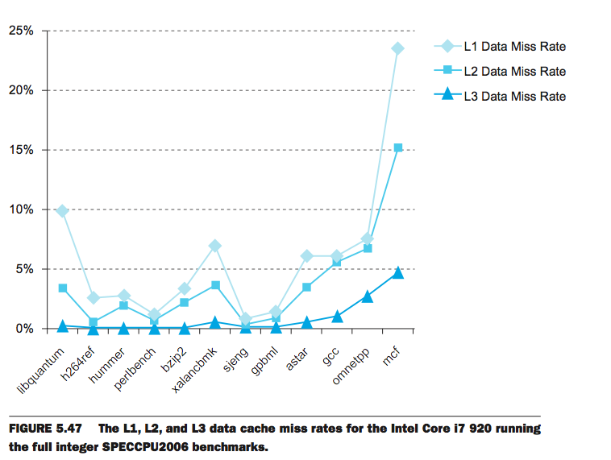
L1 Cache: 32KB I$, 32KB D$
L2 Cache: 256 KB
L3 Cache: 4 MB
Cache Buster
10/19/17
Fall 2017 - Lecture #16

Slide 47
Outline
Understanding Cache Misses
Increasing Cache Performance
Performance of Multi-level Caches (L1,L2, …)
Real world example caches
And in Conclusion …
10/19/17
Fall 2017 – Lecture #16

Slide 48
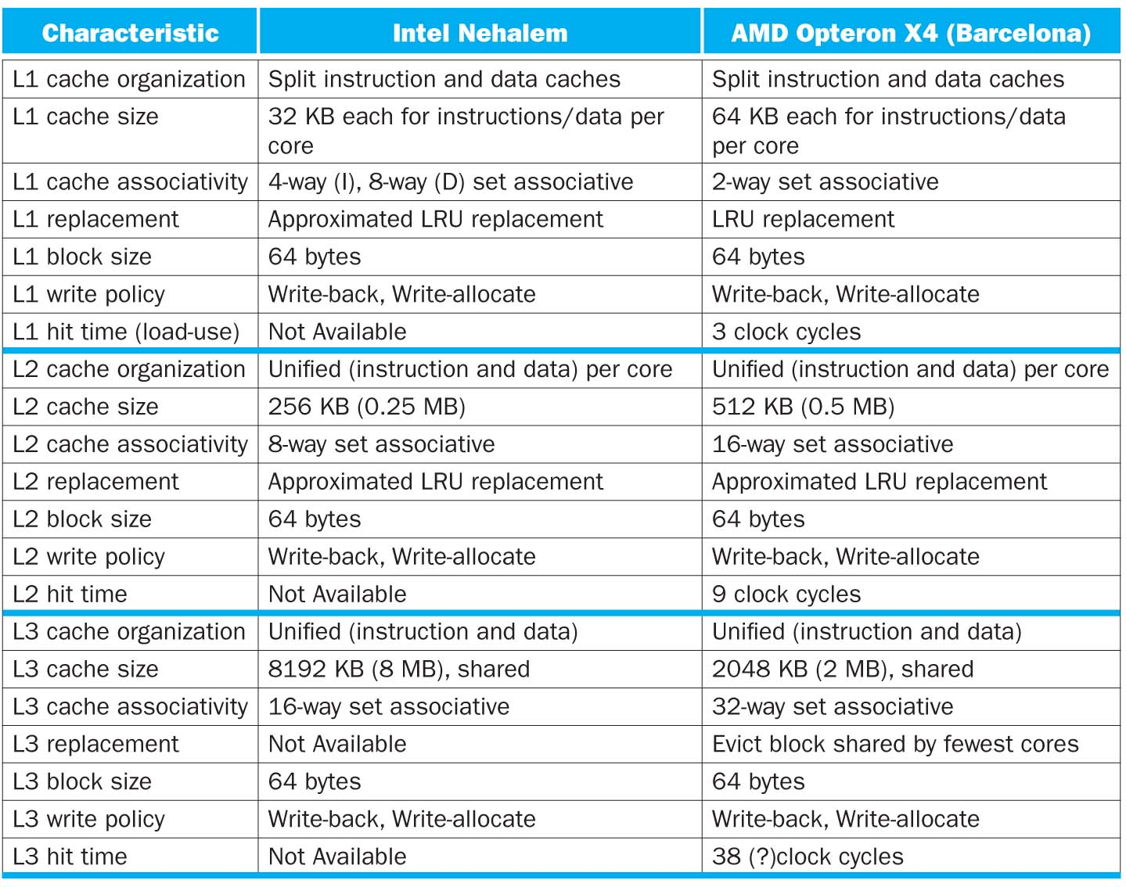
10/19/17
Fall 2017 - Lecture #16

Slide 49
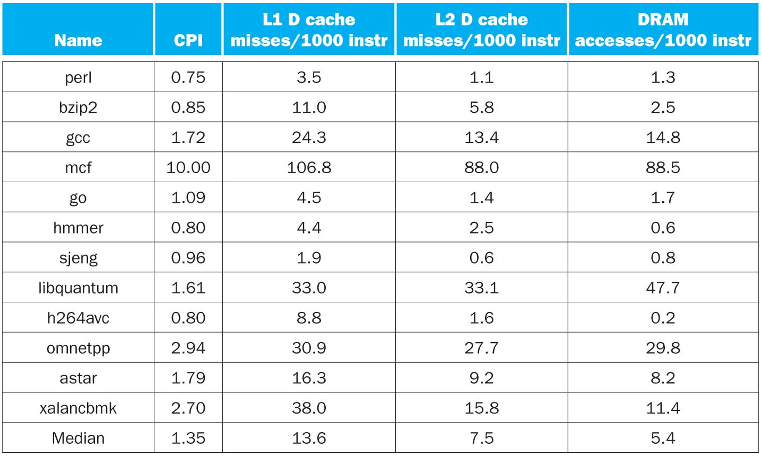
CPI/Miss Rates/DRAM Access SpecInt2006
Data Only
Data Only
Instructions and Data
Fall 2017 - Lecture #16

Slide 50
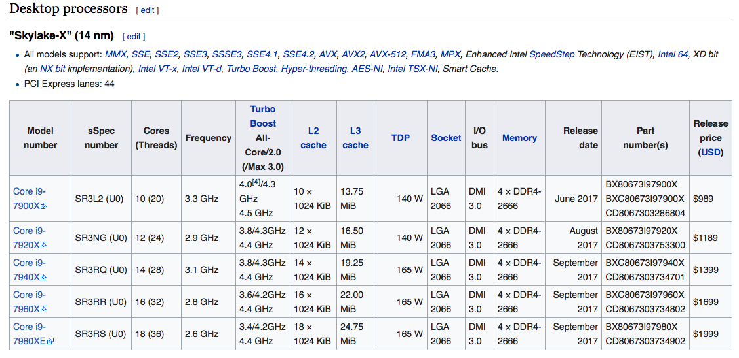
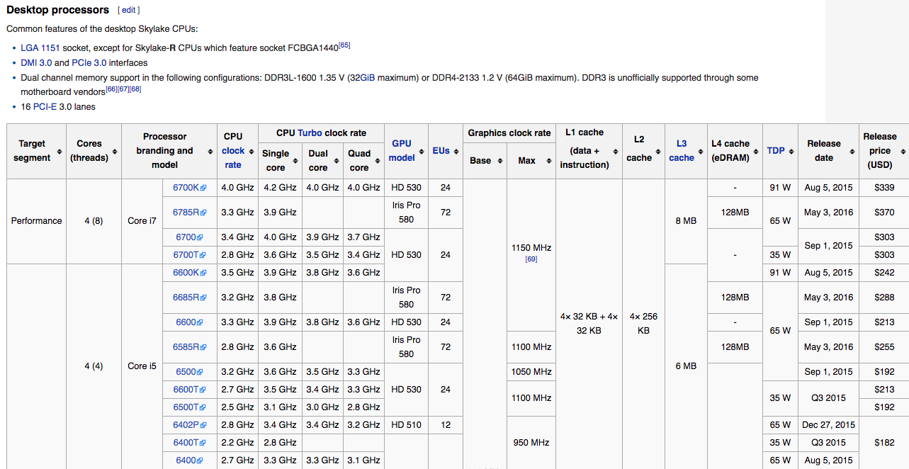
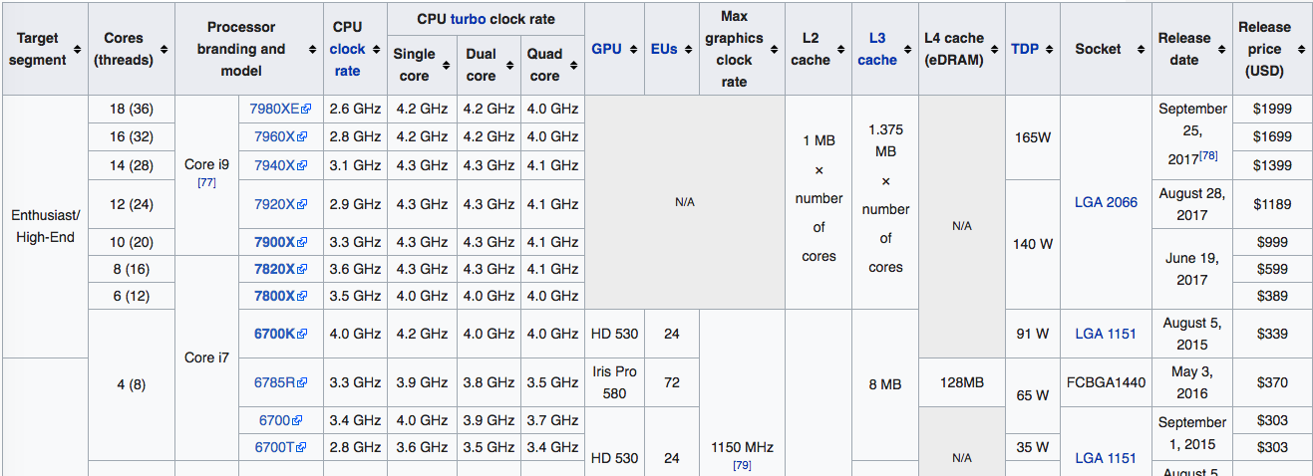
Skylark: Intel’s Recent Generation Laptop/Tablet Class CPUs

Slide 51
Outline
Understanding Cache Misses
Increasing Cache Performance
Performance of Multi-level Caches (L1,L2, …)
Real world example caches
And in Conclusion …
10/19/17
Fall 2017 – Lecture #16

Slide 52
Bottom Line: Cache Design Space
Several interacting dimensions
Cache size
Block size
Associativity
Replacement policy
Write-through vs. write-back
Write allocation
Optimal choice is a compromise
Depends on access characteristics
Workload
Use (I-cache, D-cache)
Depends on technology / cost
Simplicity often wins
Cache Size
Associativity
Block Size
Bad
Good
Factor A
Factor B
Less
More
10/19/17
Fall 2017 - Lecture #16
Notes:
No fancy replacement policy is needed for the direct mapped cache.
As a matter of fact, that is what cause direct mapped trouble to begin with: only one place to go in the cache--causes conflict misses.
No fancy replacement policy is needed for the direct mapped cache.
As a matter of fact, that is what cause direct mapped trouble to begin with: only one place to go in the cache--causes conflict misses.
Besides working at Sun, I also teach people how to fly whenever I have time.
Statistic have shown that if a pilot crashed after an engine failure, he or she is more likely to get killed in a multi-engine light airplane than a single engine airplane.
The joke among us flight instructors is that: sure, when the engine quit in a single engine stops, you have one option: sooner or later, you land. Probably sooner.
But in a multi-engine airplane with one engine stops, you have a lot of options. It is the need to make a decision that kills those people.

